Slide 1
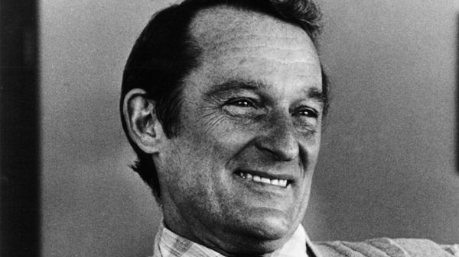
Seymour Cray
Created by Sela

Slide 2
Seymour Cray
Birth: September 28, 1925
Where: Chippewa falls Wisconsin, U.S
Died: October 5, 1995,
Where: Colorado Springs

Slide 3
Why is Seymour Cray important?
Seymour Clay was an American electronics engineer and a computer designer who was the finest designer of the large high-speed computers known as supercomputers. Cray graduated from the university of Minnesota in 1950 with a bachelor's degree in electrical engineering.

Slide 4
How did it impact computing?
What lead them into computing?
Cray was inspired by his father Seymour R. who was a civil engineer he encouraged Cray's interest in science and engineering.
Cray invented CDC 1604, one of the first computers that can replace vacuum tubes with smaller transistors. Cray later helped created the CDC 6600 which at that time was the fastest computer in the world in 1964 and was able to accomplish 3 million floating- point operations per second.

Slide 5
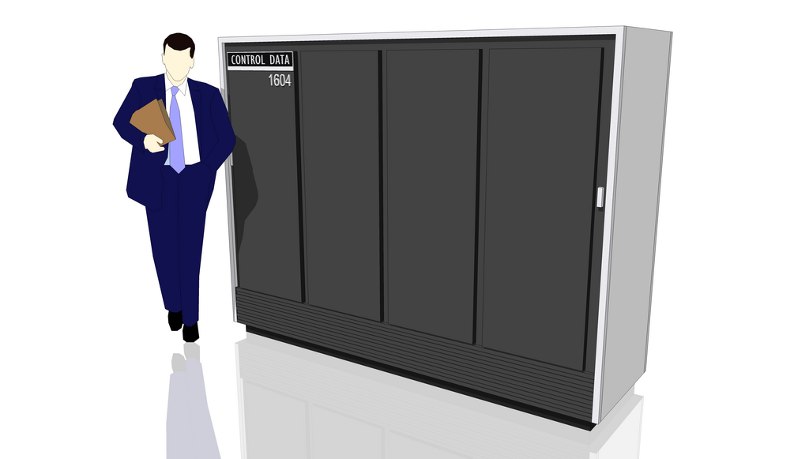
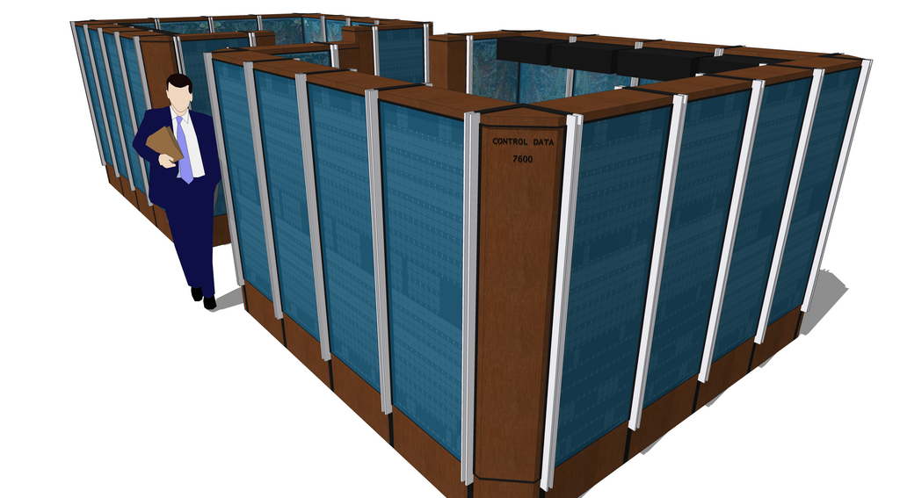
How is their work still relevant?
CDC 1604 is the first invention that Seymour Cray invented with his team CDC, CDC 1604 was the first commercially successful transistorized computers.
Cray's work is still relevant because he invented 12 computers that was created in 1953- 1993 some were cancelled and some were not produced, Cray along with William Norris became irritated with ERA, then in 1957 they founded a new company Control data Corporation to help them create more technology for the future generation.
CDC 7600 was created by Seymour to extend the control data's power of the supercomputer field into the 1970's.

Slide 6
Importance of File Management:
The importance of file management is important because it reduces the time students or employees their find their documents, file management can also be confusing when you don’t name your document the assignment that you completed, with your name so the reader could know who and what assignment that was handed in.

Slide 7
Summary – Key takeaways from their research.
Cray was an inventor that helped and created some of the technology from the past around 1953-1993. Cray created the fastest computer that was called supercomputer that helped with business and commercial .

